Slide 1

LIBRARY SYSTEM MANAGEMENT THESIS DEFENSE
Welcome to Group 4 presentation

Slide 2
Library System Management
Group Name: Group 4
Team Members:
Nguyễn Việt Hoàng (Leader): Backend
Hoàng Văn Anh: Frontend (Admin side)
Bùi Quang Minh: Frontend (Client side)
Nguyễn Văn Quyết: Tester (API), Seeding
Bùi Thành Đạt: Tester (Admin Side)
Nguyễn Thạch: Tester (Client Side)
Teacher: Mrs. Bùi Oanh

Slide 3

Presentation content
01
02
System Requirements
Business Analysis
03
04
Technology Application
Product Demo
Describe the system requirements
Describe the main business flows
Describe Technologies used
Present the management system program

Slide 4

01
System Requirements
Describe the system requirements

Slide 5
System Requirements
About our customer
Accessing data must be done quickly and accurately.
The interface between the user and the machine must be scientifically designed, friendly, beautiful, compact and consistent in terms of working methods and presentation.
Help readers more convenient and confident in searching and looking up with many additional functions.
Borrowing and returning documents becomes easier, eliminating the slow process of writing ballots and searching manually as before.
About us
Managing the process of borrowing and returning books just got easier
Can carry out survey activities on the needs and opinions of readers more conveniently.
Can capture the general trend of readers, improve the efficiency of the library.
Helps increase the efficiency of data management and updating
Reduce query time as well as system complexity

Slide 6
Main roles
User
Librarian
Admin
Member

Slide 7

Business Analysis
02

Slide 8
Book rental business
Here’s the steps of Book rental business:
The system displays the list of book titles, User selects any type of book to view details.
After feeling satisfied, users can click the book rental button.
Users can update the number of items they want to order as well as choose a payment type.
When the options and information are displayed, the user clicks the Checkout button.
The system will check the number of inventory books and borrowed books to validate the order data
If the number of borrowed books exceeds the number of books in stock, the system will ask the user to re-enter the number of books.
If the number of books borrowed exceeds the rental limit (default is 10 books), the system will ask the user to re-enter the number of books.
The system will display the rent and deposit for the bill.
The rent (the rent of the book * the number of books * the number of days borrowed) will be the amount to be paid immediately.
The Deposit (number of books * book price) will be deducted from the virtual wallet.
The system will check if your Virtual Wallet account balance is eligible to pay the deposit for this order.
If the condition is not enough, the system will ask you to reduce the number of items or you have to recharge.
If your Virtual Wallet account is eligible, the system will approve your account and check the account status.
The last step, the system will check your account status.
Finally, your order will be successfully checked out and you will receive a notification of order information via email.

Slide 9
CONCLUSIONS 1
1. Books
2. Order
3. Validation
6. Confirm & Notification
5. Order Success
4. Account
Choose a book to rent
Update order information
Validate order conditions
Check out successfully
Check account status
Send information via email

Slide 10
Book Return business
Here’s the steps of Book return business:
User confirm return book. (The librarian will take on the role of performing this function).
The system will check the current date and return due date.
If the user pays on time, the order item status will change to RETURN_OK. The system will update the number of books in the inventory and refund the deposit in the virtual wallet to the user.
If the user's payment is past due, the order item will change to the RETURN_OVERDUE_DATE state. The system will update the number of books in the inventory and refund the user's deposit minus the fine (fine = penalty price * days of late ).
If the user pays over the allowed limit (30 days), the system will automatically cancel the deposit in the Virtual Wallet and change the order item status to OVERDUE_LIMITED_DATE. In addition, the user account status will be changed to BLACKLISTED.
After each of the above steps, the system will generate a notification to the user account and send a confirmation email to the user.
In addition, the system also performs an automatic cron job, that is, every 7 am every day, it will send an email to all accounts that are about to be overdue for returning books.

Slide 11
CONCLUSIONS 2
1
2
3
4
Return Book
Validate date
Update
Notification
User confirm return book
System validate return date and status
Send notifications via system and mail
Update the number of books and Virtual Wallet

Slide 12
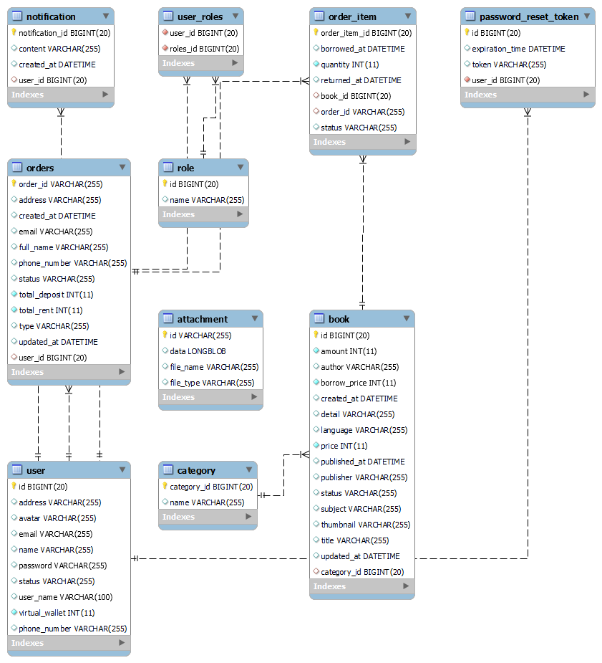
System model

Slide 13

03
Technologies used

Slide 14









Some technologies that we apply

Slide 15
System Review
 | Cleared | Passed | Completed | Optimal
Business flow of borrowing books
Business flow of returning books
Data management and statistics
Manage notifications and communications

Slide 16
What we achived ?
Core value
Study
Teamwork
Build the main business flow of the website
Learn more about various technology platforms
Develop teamwork skills and apply technologies

Slide 17

04
Product Demo

Slide 18


THANKS!

